Slide 1


Event Table
Event | Trigger | Source | Use Case | Response | Destination
VCM and Server Key generates key using Diffie-Hellman Algorithm | Server Key collects all public keys of VCMs | VCM and Server Key | Generate key using Diffie-Hellman Algorithm | Generated Key | VCM
VCM encrypts ER using VCM’s private key | Generated key using Diffie-Hellman Algorithm | VCM | Encrypt ER using private key | Encrypted ER | VCM
VCM gets hash value of ER using three hash function | Encrypted ER | VCM | Hash the ER | Three hash values of ER | VCM
VCM encrypts the encrypted ER and hash values together using the generated key in the Diffie-Hellman Algorithm | Hash values of ER | VCM | Encrypt the encrypted ER and its hash values together | Encrypted encrypted ER and hash values | VCM
VCM sends both the encrypted encrypted ER and its three hash values to Server Key | Encrypted encrypted ER and hash values | VCM | Send both the encrypted encrypted ER and its hash values | Sent encrypted encrypted ER and hash value | Server Key
Server Key receives the data and decrypts it using the Diffie-Hellman Key and the VCM’s public key | Sent encrypted encrypted ER and hash value | Server Key | Decrypt data using Diffie-Hellman Key and VCM’s public key | Decrypted ER and its hash function | Server Key
Server key hashes the decrypted ER | Decrypted data | Server Key | Hash the decrypted ER | Three hash values of the decrypted file | Server key
Server key checks if the generated hash values of the file and the hash values sent by the VCM are the same | Three hash values of the decrypted file | Servery Key | Server key checks if hash values are the same | Verified data | Server Key

Slide 2
Context Diagram
Transparency Server
Encrypted data
Encrypted data
Encrypted data
VCM
Automated Election System
Encrypted data
Central Server
Encrypted data
Encrypted data
Encrypted data
Encrypted data
CCS

Slide 3
DFD DIAGRAM 0
votes
2
Store votes in database
5
Transmit election returns to Municipal BOC
Precinct
ERs
Votes
Municipal
BOC
1
Cast ballots
summary of votes
stored votes
6
Transmit election returns to Provincial BOC
4
Accumulates votes
votes
3
Print receipt
Voter
Municipal ERs
Accumulated
votes
Election Returns
ProvincialBOC
receipt
digital signature
BEI
8
Transmit election returns to National BOC
7
Transmit election returns to Regional BOC
Regional ERs
Provincial ERs
NationalBOC
RegionalBOC

Slide 4
DFD DIAGRAM 1

Slide 5
Activity Diagram
Servers(CSS,Central and Transparency) | VCM
Sends encrypted data
Decrypts the data
Sends encrypted ERs
Creates key exchange
Verifies hash value

Slide 6
Communication Diagram
1.1:DecryptData()
1:sendEncryptedData()
2:CreateKeyExchange()
3:SendEncryptedERs()
:Servers
(CCS, Central and Transparency)
:VCM
4:verifiesHashValue()
2:CreateKeyExchange()

Slide 7
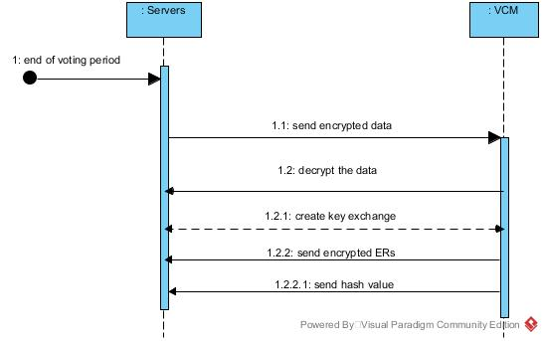
Sequence Diagram

Slide 8
State Diagram
VCM public key
Send encrypted data
Private key
Decrypt data
Verify hash value
Encrypted ERs
Create key exchange
Generated key
Send encrypted ERs

Slide 9
Timing Diagram
Encrypt data
Decrypt data
Create key exchange
Send encrypted ERs
Verify hash value
|--------30s--------|-----------30s------------|----------30s----------|----------30s----------|---------30s---------|

Slide 10
Interaction Overview Diagram
Sd VoteTransmission

Slide 11
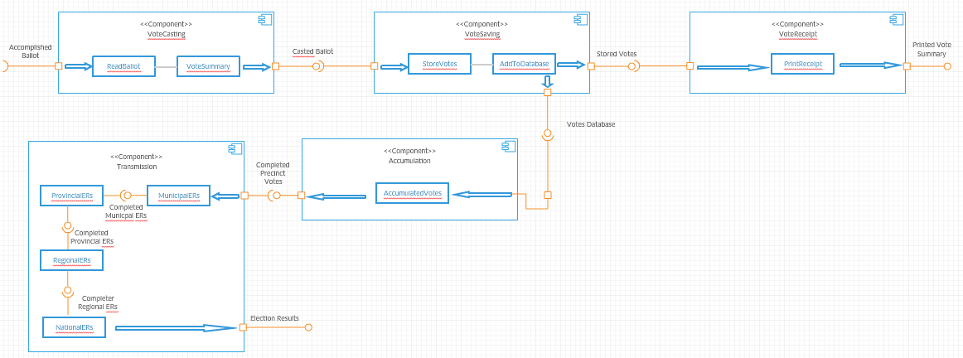
Component Diagram

Slide 12
Composite Diagram
TransmissionVotes
Central Server
VCM
Transparency Server
Hybrid Cryptography of AES
Transparency Server

Slide 13
Use Case Diagram
CCS, Central, Transparency Server
Send encrypted data
VCM

Slide 14
Use Case Diagram
VCM
Decrypt data
CCS, Central, Transparency Server

Slide 15
Use Case Diagram
CCS, Central, Transparency Server
Create key exchange
VCM

Slide 16
Use Case Diagram
VCM
Send encrypted ERs
CCS, Central, Transparency Server

Slide 17
Use Case Diagram
CCS, Central, Transparency Server
Verify hash value

Slide 18
Use Case Diagram w Full Description
Use Case Name: | Send encrypted data
Scenario: | CCS, Central Server and Transparency Server sends encrypted data to VCM using the VCM’s public key
Triggering Event: | End of voting period
Brief Description: | The three main servers send a message to the VCM that is encrypted using the VCM’s public key
Actor(s): | VCM, CCS, Central Server, Transparency Server
Related Use Cases: | ---
Stakeholders: | The VCM will receive the data sent by the servers The three servers will have to send the encrypted data
Precondition: | Voting Period closes
Postcondition: | Sent encrypted data
Basic Flow: | Actor: 1. The Comelec closes the voting period | System Response: 1.1 The CCS. Central Server, and the transparency server sends a message to the VCMs to initiate the vote transmissions.
Exceptions: | The machines being used have defects making it impossible to communicate

Slide 19
Use Case Diagram w Full Description
Use Case Name: | Decrypts the data
Scenario: | VCM decrypts the data using its private keys
Triggering Event: | Received encrypted data
Brief Description: | In order for the VCM to read the data sent by the servers, it has to decrypt it using its very own private key.
Actor(s): | VCM, CCS, Central Server, Transparency Server
Related Use Cases: | Send encrypted data
Stakeholders: | The VCMs must decrypt the data using the private key assigned to it
Precondition: | Sent encrypted data
Postcondition: | Decrypted the data
Basic Flow: | Actor: 1. Poll watchers ensure that no one will intervene the transmission process. | System Response: 1.1 The System will decrypt the data that was encrypted and interpret it into a language that is understandable.
Exceptions: | The machines being used have defects making it impossible to communicate. Human intervention is present and the system fails to serve its purpose.

Slide 20
Use Case Diagram w Full Description
Use Case Name: | Creates key exchange
Scenario: | VCM & 3 Servers create key exchange using the Diffie-Hellman algorithm
Triggering Event: | Successfully decrypted data
Brief Description: | A security algorithm is used by the VCM and servers in order to generate their own key.
Actor(s): | VCM, CCS, Central Server, Transparency Server
Related Use Cases: | Decrypts the data
Stakeholders: | The VCM and servers must create a key
Precondition: | Decrypted the data
Postcondition: | Generated Key
Basic Flow: | Actor: 1. Poll watchers ensure that no one will intervene the transmission process. | System Response: 1.1 VCM and secret servers will communicate with each other 1.2 They will be able to generate a key exchange.
Exceptions: | The machines being used have defects making it impossible to communicate. Human intervention is present and the system fails to serve its purpose.

Slide 21
Use Case Diagram w Full Description
Use Case Name: | Sends encrypted ERs
Scenario: | VCM sends encrypted election returns using the generated key
Triggering Event: | Generated Key
Brief Description: | After the key exchange, the VCM will transmit the ERs that were encrypted using the generated key.
Actor(s): | VCM, CCS, Central Server, Transparency Server
Related Use Cases: | Creates key exchange
Stakeholders: | VCM should transmit encrypted ERs to the servers that communicated to it.
Precondition: | Generated Key
Postcondition: | Sent encrypted ERs
Basic Flow: | Actor: 1. Poll watchers ensure that no one will intervene the transmission process. | System Response: 1.1 The VCM will transmit encrypted votes to the servers. 1.2 Servers will receive them
Exceptions: | The machines being used have defects making it impossible to communicate. Human intervention is present and the system fails to serve its purpose.

Slide 22
Use Case Diagram w Full Description
Use Case Name: | Verifies hash value
Scenario: | CCS, Central Server and, Transparency Server verify hash value of the received election returns
Triggering Event: | Completion of Precinct Votes
Brief Description: | Received encrypted election returns
Actor(s): | VCM, CCS, Central Server, Transparency Server
Related Use Cases: | Sends encrypted ERs
Stakeholders: | Servers will determine if the hash values are authentic
Precondition: | Sent encrypted ERs
Postcondition: | Verified Hash Value
Basic Flow: | Actor: 1. Poll watchers ensure that no one will intervene the transmission process. | System Response: 1.1 The servers will check the ER’s integrity by looking at the hash code. 1.2 Servers will now include the data in the official count of the votes if the hash codes matches. 1.3 In the event that there was an anomaly in the hash, the servers won’t accept the data thus calling the attention of the administrators.
Exceptions: | The machines being used have defects making it impossible to communicate. Human intervention is present and the system fails to serve its purpose.

Slide 23
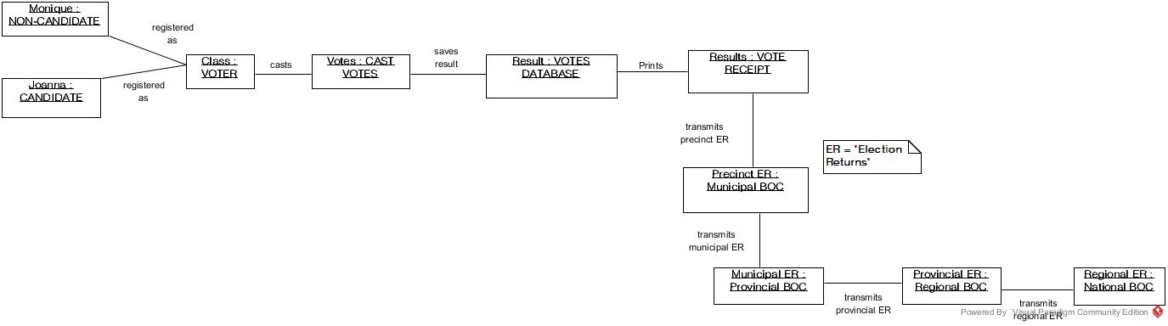
Object Diagram

Slide 24
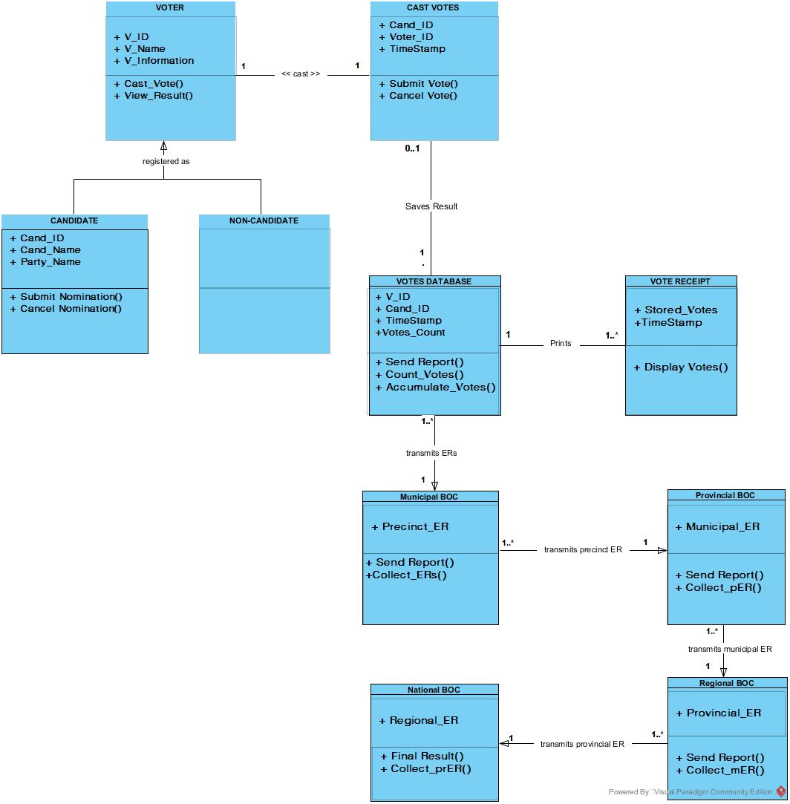
Class Diagram

Slide 25
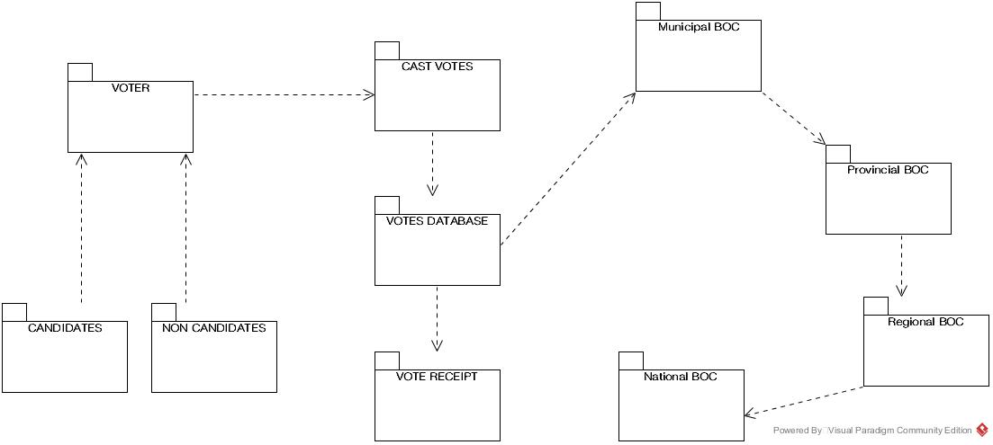
Package Diagram

Slide 26
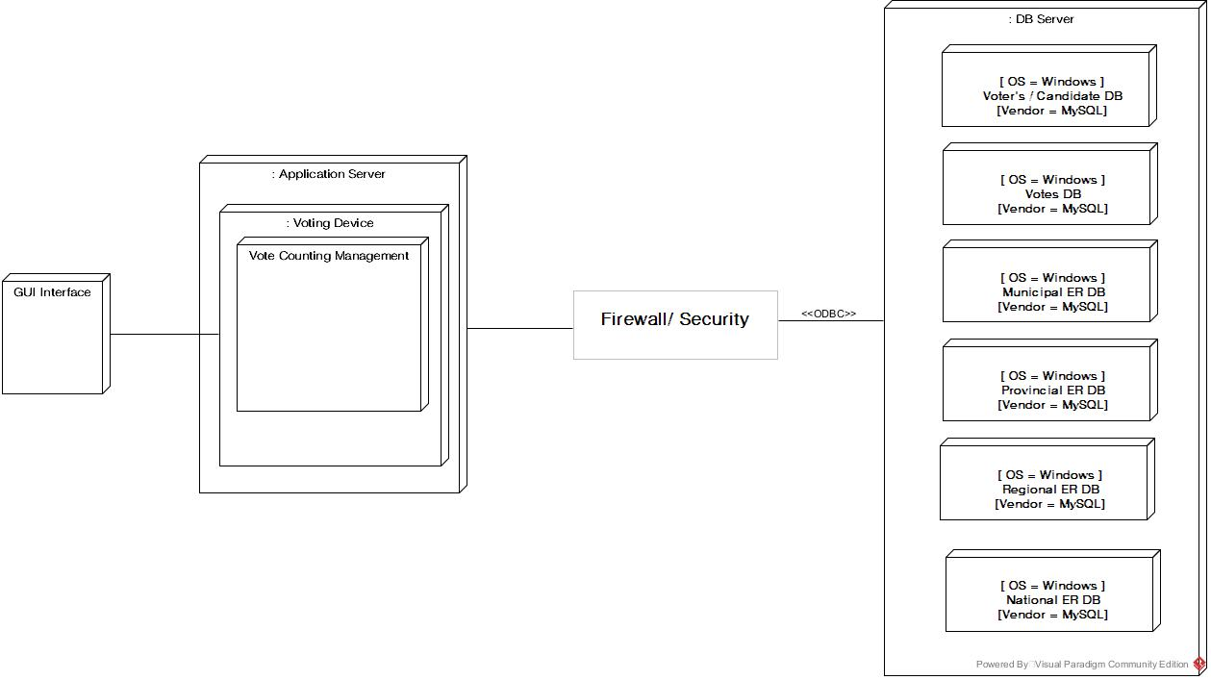
Deployment Diagram

